Slide 1
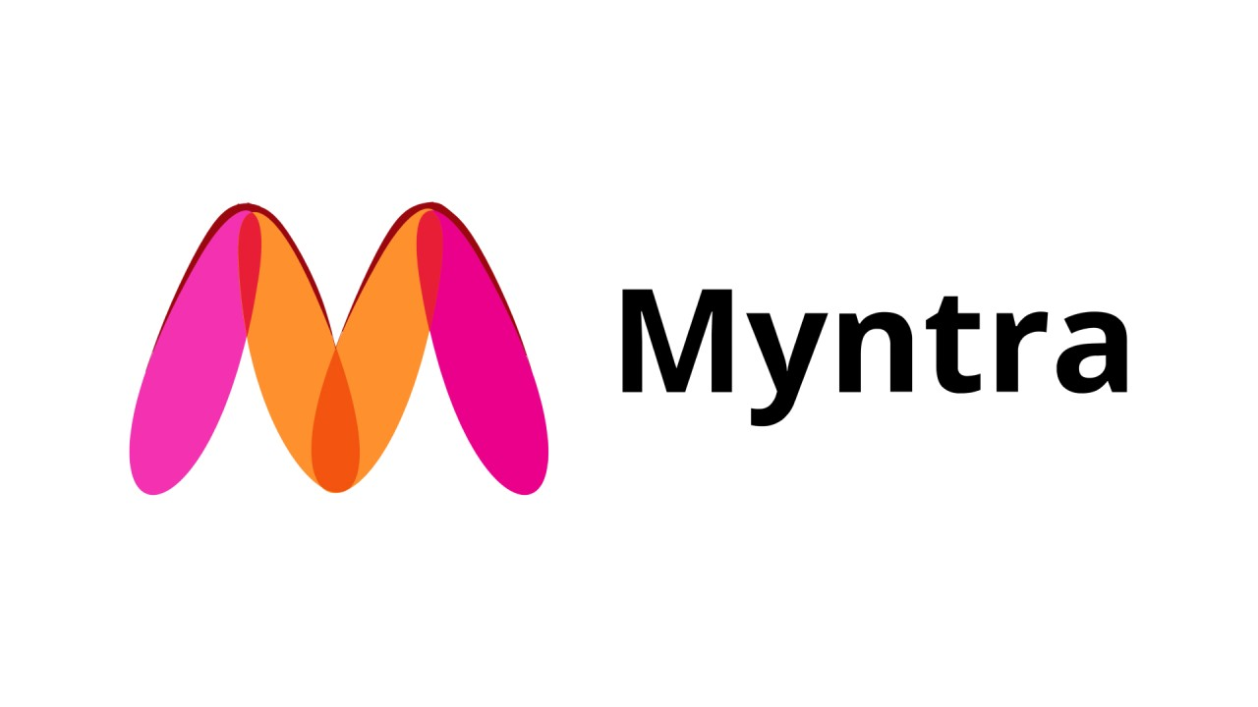
MYNTRA ANALYSIS

Slide 2
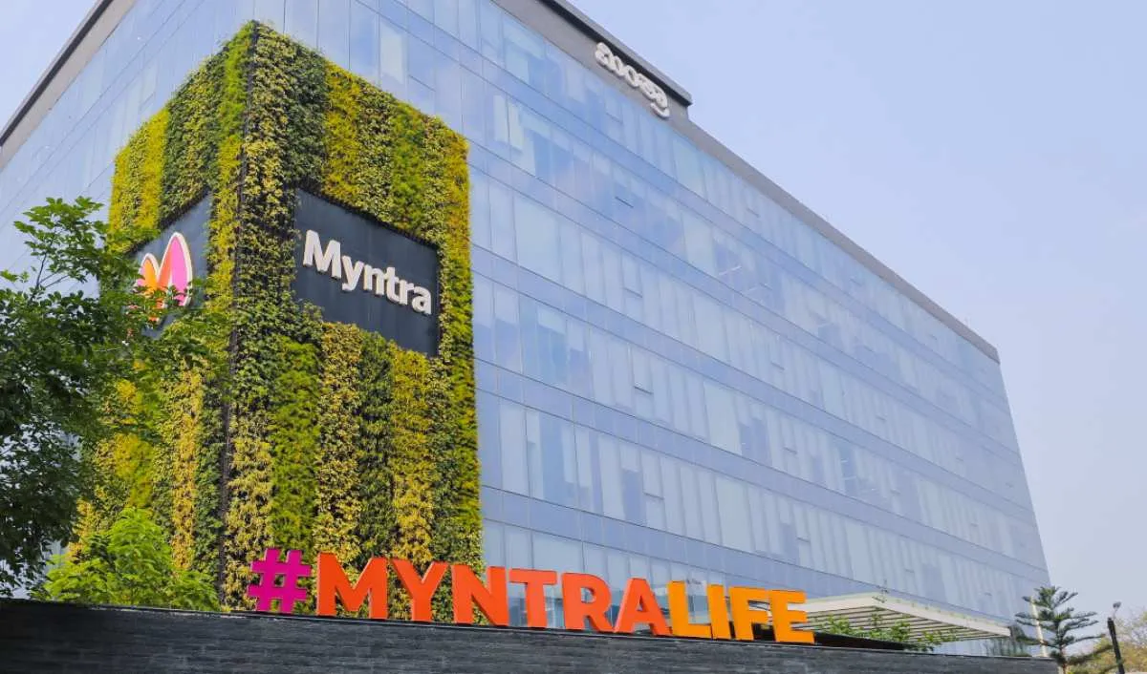
COMPANY PROFILE
Profile
-Established in 2007 by Mukesh Bansal
-Leading Indian e-commerce platform
-Specialised in fashion and lifestyle products
Acquisition
-Acquired by Flipkart in 2014
Mission
Provide hassle free and enjoyable shopping experience to shoppers across the country with the widest range of brands and products
.

Slide 3
BUSINESS MODEL
Myntra’s business model focuses on leveraging a comprehensive product range, advanced technology, and a strong logistics network to drive growth and maintain leadership in the Indian fashion e-commerce market.
1.Revenue Streams:
Product Sales: Revenue from selling a wide range of fashion and lifestyle products, including clothing, footwear, and accessories.
Marketplace Commissions: Earnings from commissions on sales by third-party vendors and brands on its platform.
Advertising Fees: Revenue from brands paying for enhanced visibility and advertising options on Myntra.
2. Key Components:
E-commerce Platform: A user-friendly website and mobile app for browsing, purchasing, and managing orders.

Slide 4
Product Range: Extensive selection of local and international brands, along with exclusive and private label collections.
Logistics Network: Fulfillment centers and partnerships with third-party logistics providers to ensure efficient delivery and returns.
3. Competitive Advantages:
Market Leader: Largest fashion e-commerce platform in India with strong brand recognition.
Personalization: Data-driven personalized recommendations and marketing.
Diverse Inventory: Broad product range and exclusive offerings.
4. Challenges:
Customer Service: Issues related to handling returns and customer complaints.
Competition: Intense competition from other e-commerce giants and niche players.
Logistics: Ensuring timely and reliable delivery.

Slide 5
Social Media Strategy
Social Media Analytics
Customer Review and Feedback
-Trend Identification
-Sentimental Analysis
-Influencer Collaborations
-Product Improvement
-Enhanced Customer Service
Personalization and Targeting
Product Launch and Strategy
-Tailored Recommendations
-Target Marketing Campaigns
-Data Driven Decisions
-Competitive Analysis
Performance Measurement
Customer Engagement
-Community Building
-Real-Time Feedback
-Campaign Effectiveness
-Customer Insight

Slide 6
Social Media Analytics
Trend Identification: Myntra monitors social media platforms to identify emerging fashion trends, popular styles, and customer preferences. This helps in adjusting inventory and marketing strategies to align with current trends.
Sentiment Analysis: By analyzing customer engagment from social media conversations, Myntra gauge customer opinions about its products and services. Positive sentiments can be leveraged in marketing, while negative feedback can be addressed to improve customer satisfaction.
Influencer Collaborations: Myntra partners with fashion influencers and celebrities to reach a broader audience and build brand credibility. Insights from these collaborations help refine targeting strategies and content creation.

Slide 7
Customer Reviews and Feedback
Product Improvement: Customer reviews provide valuable feedback on product quality, fit, and design. Myntra uses this information to make improvements to existing products and to guide new product development.
Enhanced Customer Service: Analyzing reviews helps identify recurring issues or concerns. Myntra can then address these issues proactively, improving overall customer service and satisfaction.
Reputation Management: Responding to reviews, both positive and negative, allows Myntra to engage with customers directly and demonstrate its commitment to customer care. This can enhance brand loyalty and trust.

Slide 8

Personalization and Targeting
Tailored Recommendations: Insights from social media and customer reviews help Myntra refine its recommendation algorithms. Personalized product suggestions based on customer preferences and past behaviour can drive higher engagement and sales.
Targeted Marketing Campaigns: Myntra uses social media insights to create targeted advertising campaigns that resonate with specific customer segments, improving the effectiveness of its marketing efforts.

Slide 9
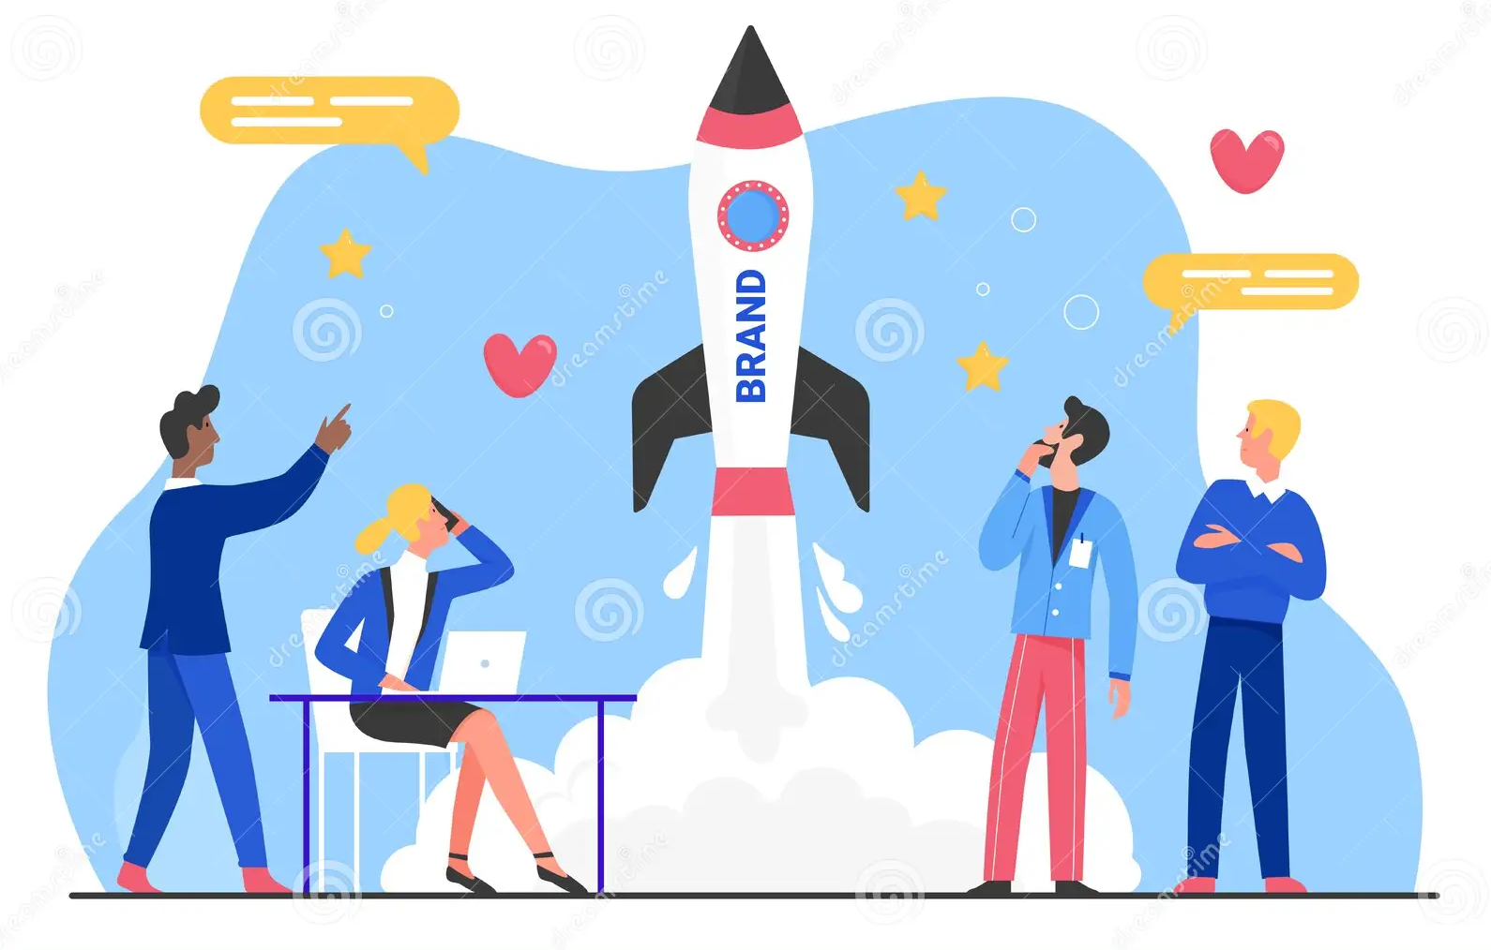
Product Launch and Strategy
Data-Driven Decisions: Social media trends and customer reviews provide data-driven insights that inform product launch strategies. Myntra can prioritize launching products that align with current consumer interests and needs.
Competitive Analysis: By monitoring competitors’ social media presence and customer feedback, Myntra can identify gaps in the market and opportunities for differentiation.

Slide 10

Customer Engagement
Community Building: Myntra leverages social media to build and engage with its community. Interactive content, such as polls and Q&A sessions, fosters a connection with customers and encourages brand loyalty.
Real-Time Feedback: Social media allows Myntra to gather real-time feedback from customers, which can be used to quickly address issues and adapt strategies.

Slide 11

Performance Measurement
Campaign Effectiveness: Social media and review analytics help Myntra measure the effectiveness of marketing campaigns and product performance. Metrics such as engagement rates, sentiment scores, and review ratings provide insights into campaign success and areas for improvement.
Customer Insights: Regular analysis of social media and review data helps Myntra stay informed about customer preferences and market dynamics, enabling agile responses to changing trends.

Slide 12
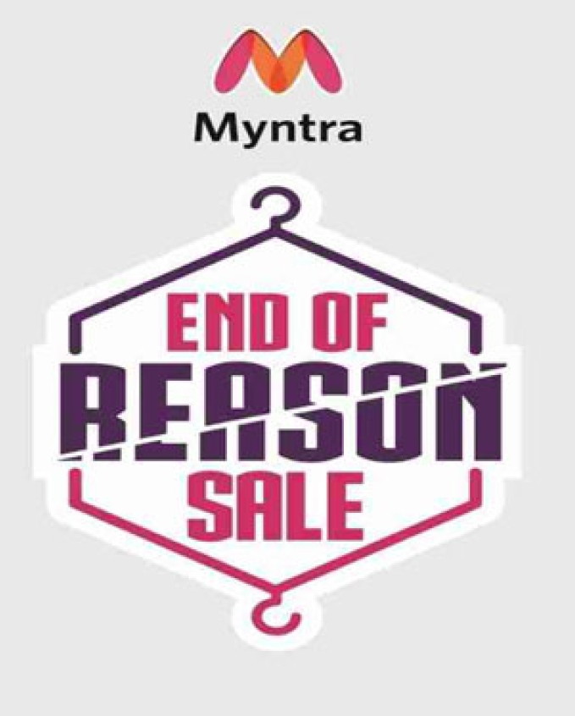
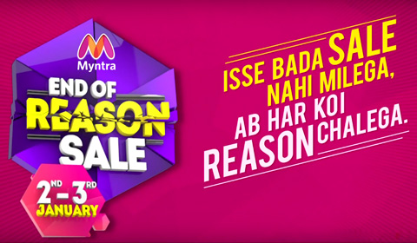
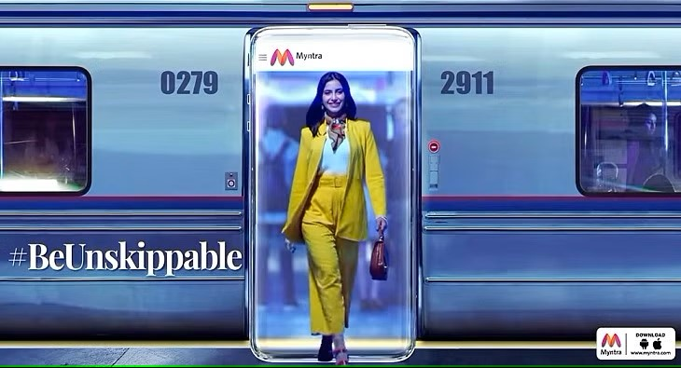
Marketing Campaigns
1
‘Ab Har Koi Reason Chalega’
3
‘End of Reason Sale’
A hearted medly to represent the iconceptual strategy that was emerged with a light mportance and nature of enjoyable occasion
2
#BeUnskippable Campaign
A new brand initiative that emphasized its position as a go-to resource for fashion for its clients

Slide 13


STRATEGIC SHIFTS
Acquisition by Flipkart
Myntra’s acquisition by Flipkart in 2014 for approximately $300 million marked a strategic move that amalgamated two industry giants. This collaboration expanded Myntra’s reach and provided access to invaluable resources and expertise.
MENSA program
Myntra's initiatives, such as the MENSA program, support small-scale shopkeepers and delivery partners, fostering a community-centric business environment. The company also collaborates with artisans, providing them a platform to reach a broader audience, thus promoting traditional crafts.

Slide 14


COVID-19
The company has shown remarkable adaptability and growth, especially during the COVID-19 pandemic. For instance, its "End of Reason Sale" attracted 3.5 million shoppers, demonstrating its robust online presence and effective marketing strategies. Myntra has also expanded its customer base significantly, with an 86% increase in users from smaller towns and cities.
AI powered features
Aside from high-quality photos and videos, they’ve added AI-powered features like virtual try-ons, which immerse users in the shopping experience.

Slide 15
MYNTRA’S OPTIMAL APPROACH
Visuals with AI
Power of YOU
Myntra leverages stunning visuals alongside cutting-edge A features like virtual try-ons, immersing the buyer in the shopping experience
Myntra knows authenticity is key. They actively encourage user-generated content (UGC) through influencer collaborations, hashtag contests, and dedicated platforms like “#MyMyntraLook”. This real-customer content fosters trust and boosts engagement, making you feel part of the community.
Social Customer Service
Understanding the importance to respond rather than listening to queries, they actively address the concerns of customers on social media, providing prompt and efficient responses. This transparency builds trust and strengthens their brand image.

Slide 16
Gamifying the Shopping Journey
Personalization and Community focus
Static campaigns are methods that has been followed for many years. Myntra keep users hooked with interactive elements like quizzes, polls and even augmented reality filters. They also leverage livestreaming with influencers, creating a dynamic experience and fostering direct interaction.
.
Myntra goes beyond just selling clothes. They use data to personalize recommendations and tailor their outreach through targeted advertising. They also foster a sense of community with online groups and loyalty programs, leading to higher customer retention and brand loyalty.
Social Commerce
Myntra seamlessly blend social media and shopping, allowing the customers to buy directly from posts, making the journey from browsing to purchase effortless.

Slide 17
Micro-Influencer Power
Sustainability
Myntra engage with relevant micro-influencers to reach niche audiences and create deeper, more personal connections. They leverage platforms like Instagram Reels and TikTok to reach younger audiences, seamlessly integrating social commerce for a smooth buying experience. Additionally, they use personalized ad targeting to ensure users see relevant product recommendations, leading to more sales.
Myntra champions environment friendly practices and collaborates with sustainable brands, aligning with customers values.
Beyond Numbers: Matrics that matters
Myntra goes beyond just measuring sales and website traffic. They use sentiment analysis to understand how customers perceive their brand and gauge their responsiveness to customer service inquiries. This data-driven approach allows them to fine-tune their strategy and stay ahead of the curve.

Slide 18
DIGITAL MARKETING STRATEGIES
Beyond Discounts: Value and Experience
Multi-channel Marketing
Website optimization for maximum performance
Even though sales increases foot traffic, prioritize value propositions over deep discounts; Myntra focused on enhancing the shopping experience by offering curated collections, personalised recommendations, and influencer partnership
Beyond offline and online marketing, Myntra commenced to accept social media commerce, influencer marketing and interactive campaigns that gear up mobile users. They also utilized platforms such as Instagram Reels, TikTok and more to expand their reach.
Myntra uses a cloud-based solutions and scalable architecture to ensure website stability and a seamless user experience. They are also fledged with strong base to handle traffic volumes.

Slide 19
Proactive customer service with omnichannel support
Myntra provides integrated customer services using AI chatbots, social media support, and easily accessible live chat options to ensure the best support to the customers. They have a clear knowledge on how to build trust and satisfaction by provide prompt responses and personalized solutions
Logistic agility and Transparency
Myntra uphold partnership with reputed logistic companies that provide real time tracking and flexible delivery options. They never fail to proactively communicate potential delays to customers and maintain clear line of communication
Easy Return and Refund
A user-friendly option for return or refund process has streamlined the procedure in a much easier way with better automated, self-services portals and flexible return windows that reduces the friction.

Slide 20
Use customer data for personalization
Myntra ensures a clear data privacy policies and empower customers to manage their own data to personalize product recommendations and offers.
Post-sale engagement: Increasing Loyalty
Understanding the importance of maintaining a good relation-ship after sales, Myntra retains their customers by providing exclusive offers, reward programs and personalized contents. They use post-purchase follow-up and feedback mechanisms to help improve future campaigns.
Teamwork and Collaborations
Myntra has succeeded in creating a collaborative culture within the team to ensure seamless communication and alignment among the marketing, logistics, customer service and technical team.

Slide 21

Platform Evolution
Keen analysis about their key competitors and better understanding about the importance of staying up-to date on emerging technologies such as personalized shopping assistance, voice commerce and such, so that they can adapt and provide innovative experience. By constantly analysing the competitor strategy, industry trends and customer feedback helped Myntra to stay ahead of the curve and capture a large share of the online fashion market.

Slide 22
SWOT ANALYSIS
S
W
Strong brand recognition
Diverse portfolio
Exclusive brands and Collaborations
Robust Technology and User Experience
Efficient supply chain and logistics
Loyalty Program
Regular sales and Discounts
Customer service
In-house brands
Data Analytics
Acquisition of competitors
Backed by Flipkart
Dependence on Discounts
Operational Challenges
High Return Rates
Intense Competition
Market Saturation
Inherent Challenges with In-house Brands
Over-reliance on the Indian Market
Tech Glitches
Supply Chain Limitations
T
O
Intense Competition
Regulatory Challenges
Rapid Technological Changes
Economic Fluctuations
Dependence on Discounts
Supply Chain Disruptions
Shifts in Consumer Preferences
Digital Security Threats
Brand Reputation Risks
Increased Customer Acquisition Costs
Dependency on Third-Party Logistics
Expansion into Tier 2 and Tier 3 Cities
International Expansion
Diversifying Product Offerings
Enhancing Tech Capabilities
Sustainable and Eco-friendly Fashion
Collaborations and Partnerships
Private Labels and In-house Brands
Omni-channel Retailing
Enhancing Customer Loyalty Programs
Supply Chain Optimization
Personalized Shopping Experience

Slide 23

STRENGTH
Strong Brand Recognition: Myntra is one of India’s most recognized online fashion retail brands. This recognition gives it a competitive advantage and ensures a solid customer base.
Diverse Product Portfolio: Myntra offers a wide range of fashion products, including clothing, accessories, footwear, and beauty products. Their vast collection caters to a diverse audience, from budget buyers to luxury seekers.
Exclusive Brands and Collaborations: Myntra has several exclusive partnerships and collaborations with international and domestic brands and designers. They have also launched exclusive collections with celebrities, which adds to the brand’s uniqueness and appeal.

Slide 24
Robust Technology & User Experience: Myntra’s platform is known for its user-friendly interface, visual search capabilities, personalized recommendations, and augmented reality-based features like virtual trial rooms.
Efficient Supply Chain and Logistics: With strategically located warehouses and a solid logistics network, Myntra ensures timely delivery and efficient order processing, enhancing customer satisfaction.
Loyalty Program (Myntra Insider): Their loyalty program, Myntra Insider, helps in customer retention by offering benefits such as points, early access to sales, and exclusive offers.
In-house Brands: Myntra has developed and nurtured its in-house brands, catering to different customer segments and price points. This helps in improving profit margins and providing exclusive offerings to customers.

Slide 25
Regular Sales and Discounts: Events like the “End of Reason Sale” (EORS) have become highly anticipated among online shoppers. These events drive significant traffic and sales and enhance the brand’s visibility and customer engagement.
Customer Service: Myntra has invested in ensuring a satisfactory post-purchase experience for its customers, including easy returns, comprehensive customer support, and quality assurance.
Data Analytics: Myntra uses data analytics to understand customer preferences, buying patterns, and trends. This aids in inventory management, personalized marketing, and trend forecasting.
Acquisition of Competitors: Myntra’s acquisition of platforms like Jabong helped reduce competition and consolidate its market position.
Backed by Flipkart: Being a part of the Flipkart group provides Myntra with financial stability, access to a broader customer base, and synergies in operations and marketing.

Slide 26

WEAKNESS
Dependence on Discounts: Myntra, like many e-commerce platforms, often relies on discounts and sales to drive traffic and sales volume. This approach can impact profit margins and lead to customer expectations for constant discounts.
Operational Challenges: E-commerce operations can face logistical challenges, including delivery delays, mishandling of goods, or stock unavailability. These operational hiccups can sometimes affect customer satisfaction.
High Return Rates: Fashion e-commerce platforms generally tend to experience higher return rates than other sectors. This can be due to sizing issues, differences in actual product appearance versus online images, or customer dissatisfaction.

Slide 27
Intense Competition: The online fashion retail space in India is highly competitive, with several players like Amazon, Ajio, and others vying for market share. Maintaining a unique value proposition becomes challenging in such an environment.
Market Saturation: As the online shopping user base grows, there’s a potential risk of market saturation, especially in urban areas where e-commerce adoption is high.
Inherent Challenges with In-house Brands: While having in-house brands can be seen as a strength due to better margins, building and maintaining brand reputation is also challenging, especially when external brands on the platform might be more established and recognized.
Over-reliance on the Indian Market: As of 2022, Myntra’s primary focus has been on the Indian market. While this provides deep market penetration, it also means vulnerability to economic or regulatory shifts within the country.

Slide 28
Tech Glitches: Even with robust technology, Myntra, like any other e-commerce platform, can face occasional tech glitches or crashes, especially during high-traffic sales events. Such incidents can hamper the user experience and brand reputation.
Supply Chain Limitations: Although Myntra has a well-established supply chain, disruptions, be it due to external factors like the pandemic or internal inefficiencies, can pose challenges.

Slide 29
OPPORTUNITIES
Expansion into Tier 2 and Tier 3 Cities: As internet penetration grows in smaller cities and towns, there’s a vast untapped market for Myntra to explore and expand its reach.
International Expansion: While Myntra has primarily focused on the Indian market, there’s potential to tap into neighboring countries or other markets where the online fashion segment is still emerging.
Diversifying Product Offerings: Myntra can further expand its product categories, venturing into areas like luxury fashion, sustainable fashion, or specialized segments like activewear, ethnic wear, etc.

Slide 30
Enhancing Tech Capabilities: With advancements in AR (Augmented Reality), VR (Virtual Reality), and AI (Artificial Intelligence), Myntra can introduce more immersive shopping experiences, personalized shopping assistants, and virtual trial rooms.
Sustainable and Eco-friendly Fashion: With growing awareness about sustainability and environmental concerns, there’s an opportunity for Myntra to promote sustainable brands, introduce eco-friendly packaging, and implement sustainable business practices.
Collaborations and Partnerships: By partnering with more celebrities, influencers, and designers, Myntra can submit exclusive collections and further elevate its brand appeal.
Private Labels and In-house Brands: There’s an opportunity to develop further and expand in-house brands, targeting specific market segments and improving profit margins.

Slide 31
Omni-channel Retailing: Exploring offline presence through experience centers, pop-up stores, or outlets can offer a hybrid shopping experience to customers, combining the benefits of both online and offline shopping.
Enhancing Customer Loyalty Programs: Improving and expanding the ‘Myntra Insider’ program can lead to better customer retention, increased repeat purchases, and a stronger brand community.
Supply Chain Optimization: Investing in technology to optimize supply chains can result in quicker deliveries, better inventory management, and reduced operational costs.
Personalized Shopping Experience: Using data analytics and AI, Myntra can further personalize the shopping experience, offering tailored product recommendations, curated fashion advice, and customized promotions.

Slide 32

THREATS
Intense Competition: The online fashion retail market in India is highly competitive. Players like Amazon, Ajio, and others vie for the same customer base, and new entrants can increase competition further.
Regulatory Challenges: Changes in regulations about e-commerce in India, like rules around foreign direct investment (FDI) or regulations on deep discounting, can affect Myntra’s operations and profitability.
Rapid Technological Changes: The e-commerce landscape continually evolves, and staying behind in technological advancements can affect user experience and overall competitiveness.

Slide 33
Economic Fluctuations: Economic downturns, reduced consumer spending, or economic disruptions can impact sales and revenue.
Dependence on Discounts: A prolonged dependence on heavy discounting to drive sales can erode brand value and profitability.
Supply Chain Disruptions: Events like the COVID-19 pandemic highlighted the vulnerabilities in global supply chains. Any such disruptions can affect inventory, delivery timelines, and overall operations.
Shifts in Consumer Preferences: The fashion industry is notably fickle, with trends changing rapidly. An inability to keep up with these changes can result in lost sales and reduced market share.
Digital Security Threats: As an e-commerce platform, Myntra handles vast amounts of user data. Cybersecurity breaches can lead to data theft, affecting user trust and brand reputation.
Brand Reputation Risks: Any negative publicity, be it due to product quality issues, customer service complaints, or other controversies, can adversely impact the brand’s image.

Slide 34
Increased Customer Acquisition Costs: As the market becomes more saturated and competitive, the cost of acquiring new customers may increase, affecting profitability.
Dependency on Third-Party Logistics: If Myntra relies heavily on third-party logistics providers, any inefficiencies or disruptions on their end can affect Myntra’s service quality.

Slide 35
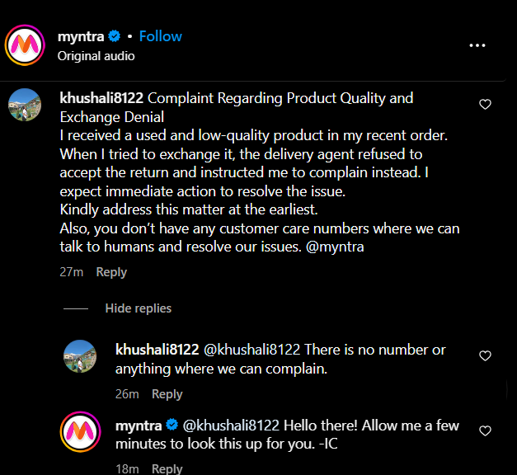
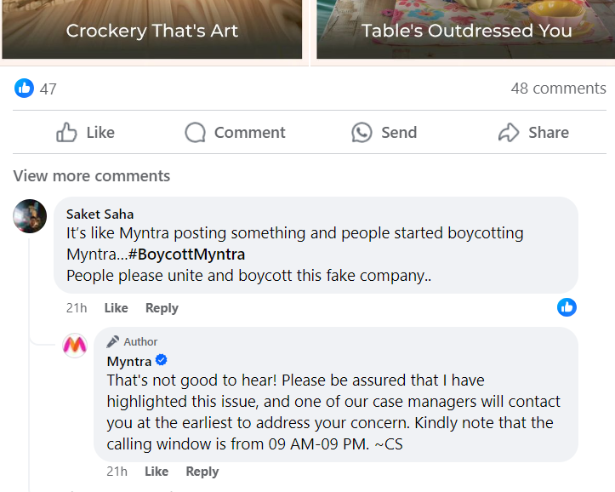

BRAND PERCEPTION ANALYSIS
Myntra indeed has a very strong social media presence and connections with their followers.
Communication methodology: Myntra has a very formal tone of communication with their customers or followers through social media. Each conversation is on a personal level. They ensure a subtle and humanised way of interaction. Furthermore; they address every user with their name and respond to the matter with better understanding.

Slide 36
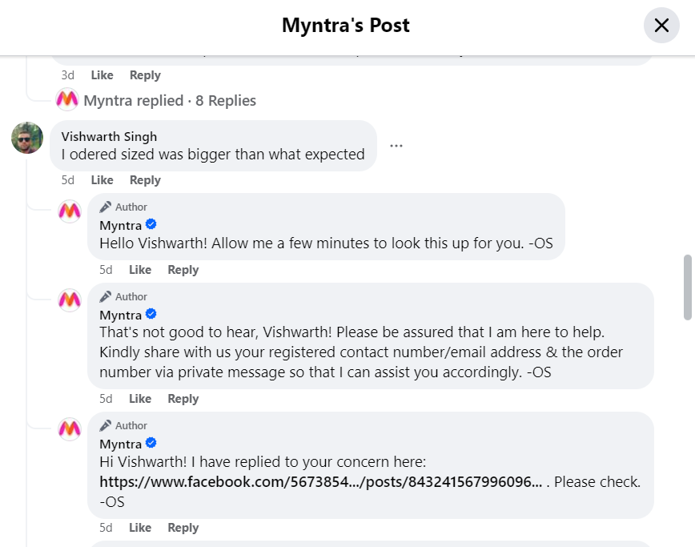

Time of Response
Myntra maintains a strong customer relationship management system and they do care about the customers perception of their brand and ensure to do their best to sustain the credibility as well. The way they respond to every queries or issues is remarkable. They assure immediate revert on the comments posted in social media with a proper understanding about the same.

Slide 37
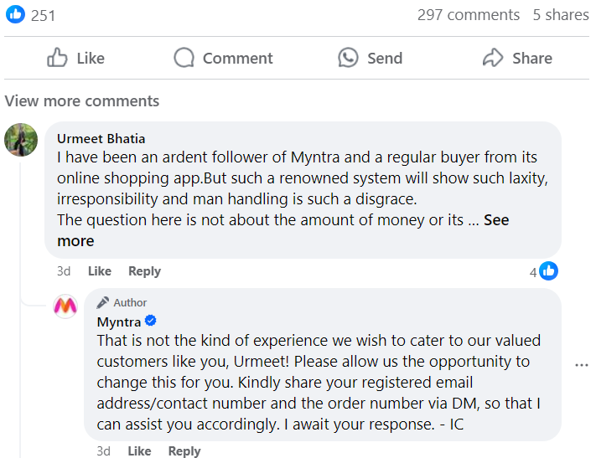

Personalised Interaction
Myntra does not send any duplicate replies. They never post a common broadcast under any issues raised by the customers. They customize messages to each queries by mentioning the names or profile id on social media. This approach itself develops a trust among the followers.

Slide 38
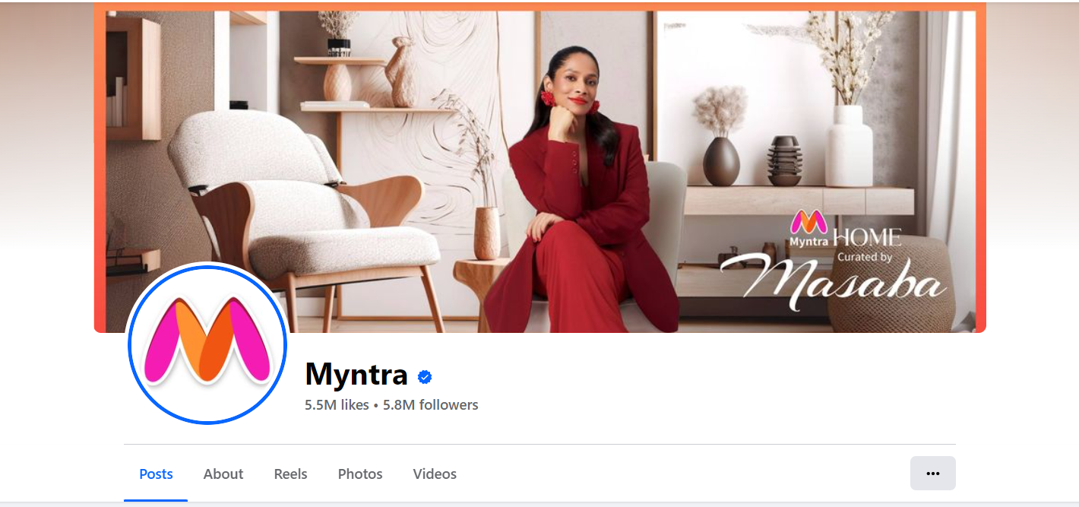
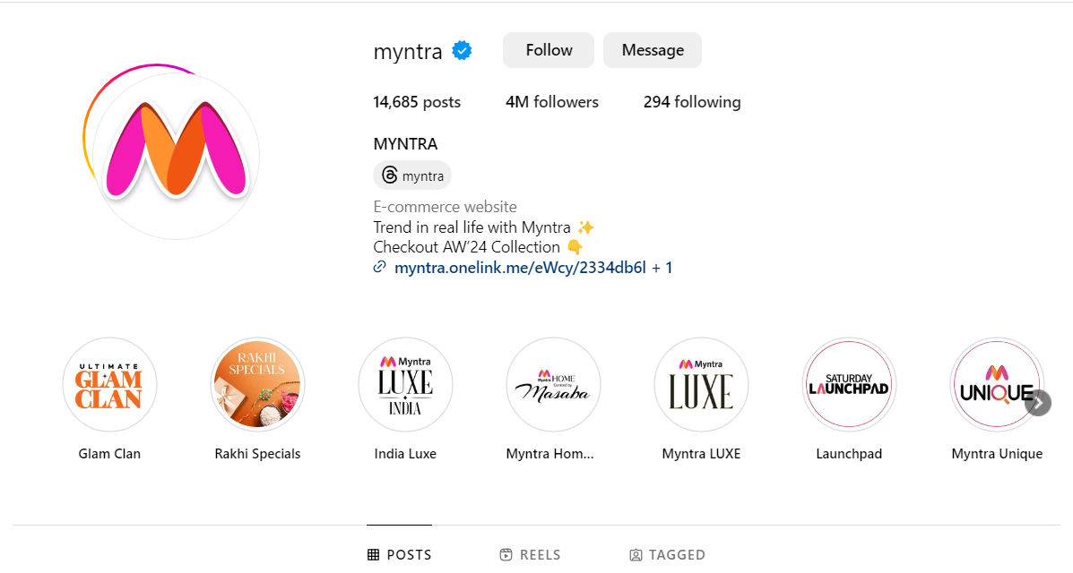
FOLLOWERS
Myntra has a comparatively good fan base and engagement on social channels. They are reasonably active on social media and try to reach the customers without much delay.
Moreover; they ensure to post all the relevant updates and activities to attract more followers and maintain existing ones.

Slide 39
Low impact
CUSTOMER REVIEW ANALYSIS
High impact
Severe complaints about product quality and customer services
Repeated failure to resolve return issues
Delivery and logistics problems
Product received in poor condition and technical glitches
General dissatisfaction and frustration
Fraud allegations and complaints about unfulfilled orders
General negative feedback

Slide 40
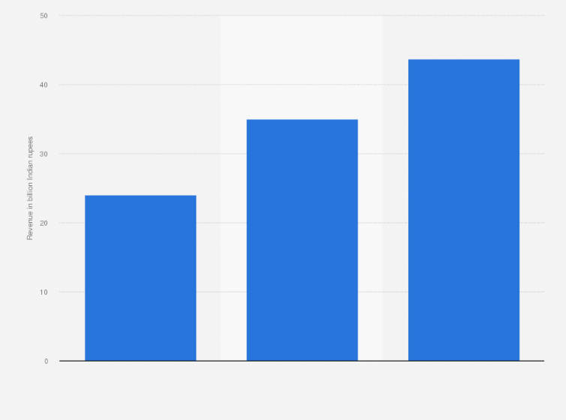
In financial year 2023, Myntra reported an operating revenue of 43.75 billion Indian rupees. This was an increase as compared to the previous year.
MYNTRA’S MARKET REVENUE ANALYSIS
Source: https://www.statista.com/statistics/1350271/myntra-operating-revenue/

Slide 41
Key aspects:
Increased Market Share: A rise in revenue suggests that Myntra has been successful in expanding its market share or increasing its average transaction size.
Effective Strategies: This growth could be attributed to successful marketing campaigns, enhanced customer experience, expanded product offerings, or other strategic initiatives.
Brand Strength: Myntra’s position as the largest fashion e-commerce platform signifies strong brand recognition and consumer trust.
Competitive Advantage: As the market leader, Myntra benefits from economies of scale, better supplier relationships, and greater leverage in negotiating terms with brands and partners.
Market Influence: Myntra’s size allows it to set trends and potentially influence market dynamics, such as pricing strategies and product availability.
Economic Conditions: Economic factors such as inflation, consumer spending power, and market conditions can influence both revenue growth and operational strategies.

Slide 42
COMPARATIVE STUDY OF MYNTRA AND MAJOR COMPETITORS

Slide 43
1.PRODUCT RANGE
Myntra:
Variety: Offers a broad range of fashion and lifestyle products, including clothing, footwear, accessories, and home décor. Features exclusive collections and collaborations with various designers and brands.
Brands: Carries a wide array of local and international brands, providing extensive options for different customer preferences.
Competitors:
Amazon Fashion:
Variety: Extensive range of clothing, footwear, and accessories. Amazon's platform supports a large inventory with products from numerous brands.
Brands: Includes a mix of high-street and luxury brands, often with a focus on affordability and variety.

Slide 44
Flipkart:
Variety: Similar to Myntra, offers a comprehensive selection of fashion products. Flipkart is known for its diverse product categories and competitive pricing.
Brands: Features a mix of local and international brands with an emphasis on providing a broad selection at various price points.
Ajio:
Variety: Known for its trendy and curated collection, focusing on contemporary fashion and unique styles. Ajio emphasizes on exclusive and trendy pieces.
Brands: Carries a selection of both established and emerging brands, with a strong focus on fashion-forward items.

Slide 45
2. PRICING
Myntra:
Pricing Strategy: Offers a range of products from affordable to high-end. Frequent sales, discounts, and promotions are a key feature.
Positioning: Positioned as a mid-to-premium fashion retailer, often providing good value for money with occasional premium products.
Competitors:
Amazon Fashion:
Pricing Strategy: Generally competitive with a focus on value and affordability. Offers frequent discounts and deals.
Positioning: Known for its wide price range, catering to budget-conscious and premium customers alike.

Slide 46
Flipkart:
Pricing Strategy: Competitive pricing with a focus on affordability. Regular sales and promotions to attract price-sensitive customers.
Positioning: Strong in the budget to mid-range segment, with efforts to offer value for money.
Ajio:
Pricing Strategy: Competitive pricing with an emphasis on trendy, exclusive items. Offers regular sales and discounts.
Positioning: Known for stylish and trendy fashion at competitive prices, often targeting a younger demographic.

Slide 47
3. CUSTOMER SATISFACTION
Myntra:
Strengths: Known for a user-friendly platform, extensive product range, and efficient delivery. Offers a robust return policy and customer support.
Weaknesses: Customer complaints often revolve around delivery issues, customer service, and occasional product quality concerns.
Competitors:
Amazon Fashion:
Strengths: Strong reputation for customer service, fast delivery, and a hassle-free return process. Large scale and reliability contribute to high customer satisfaction.
Weaknesses: Occasional issues with third-party sellers and product quality can affect overall satisfaction.

Slide 48
Flipkart:
Strengths: Good customer service, competitive pricing, and frequent promotions. Generally reliable delivery and return services.
Weaknesses: Similar to Myntra, issues with delivery and product quality can sometimes arise.
Ajio:
Strengths: Positive feedback for trendy selections and good customer service. Efficient return and exchange policies.
Weaknesses: Delivery times and occasional product quality issues can impact customer satisfaction.

Slide 49
4. SOCIAL MEDIA PRESENCE
Myntra:
Social Media Strategy: Active on platforms like Instagram, Facebook, and Twitter. Uses social media for brand promotion, influencer collaborations, and customer engagement.
Content: Focuses on fashion trends, new arrivals, and promotional offers. Engages with users through interactive content and collaborations with fashion influencers.
Competitors:
Amazon Fashion:
Social Media Strategy: Leverages Amazon’s vast network to promote products and deals. Engages users with promotions and exclusive offers.
Content: Emphasizes deals, product features, and customer reviews.

Slide 50
Flipkart:
Social Media Strategy: Active on major platforms with a focus on promotions and sales events. Engages customers with interactive campaigns and contests.
Content: Highlights offers, product range, and customer testimonials.
Ajio:
Social Media Strategy: Strong presence on platforms like Instagram and Facebook, focusing on trendy fashion and exclusive collections.
Content: Emphasizes style trends, exclusive collections, and influencer partnerships.

Slide 51
MYNTRA
ADVANTAGES
DISADVANTAGES
Wide Product Range: Extensive selection of fashion items, including exclusive collections and designer collaborations.
User Experience: Well-developed e-commerce platform with user-friendly features and efficient delivery.
Brand Positioning: Established as a leading fashion e-commerce platform with strong brand recognition.
Customer Service Issues: Some complaints about service quality and handling of returns or exchanges.
Delivery Concerns: Issues with delivery times and service reliability can impact customer satisfaction.
Competitive Pressure: Faces strong competition from Amazon Fashion, Flipkart, and Ajio, which may offer similar or better pricing and customer service in certain areas.

Slide 52
STRATEGIC RECOMMENDATIONS
Enhance customer satisfaction: Improve customer service by providing proper training and development programs, implementing multi-channel support with quick action, introducing a dedicated support team to handle high priority issues and by creating easy –to-use feedback system where customers can report issue and track resolutions.
Optimize Returns and Exchanges:Simplify the returns and exchange process to make it more customer-friendly. Implement a no-questions-asked return policy for certain categories to build trust. Partner with reliable logistics providers to ensure timely and efficient delivery and returns. Invest in technology to track shipments and provide real-time updates to customers.
Personalize Customer Experience: Use data analytics to offer personalized recommendations based on browsing history, past purchases, and customer preferences. Enhance loyalty programs with personalized rewards, exclusive offers, and early access to sales based on customer behavior.
Loyalty programs: Enhance loyalty programs with personalized rewards, exclusive offers, and early access to sales based on customer behavior.

Slide 53

Diversify Product Range: Forge exclusive partnerships with designers and brands to offer unique collections that cannot be found elsewhere. Expanding product categories to include more niche segments, such as eco-friendly fashion, plus-size options, or premium luxury items will attract new customers.
Content Marketing: Create engaging content that resonates with the target audience, including fashion tips, trend reports, and behind-the-scenes looks at new collections.
Brand Differentiation: Clearly communicate Myntra’s unique value propositions, such as exclusive product offerings or exceptional customer service, to differentiate from competitors.
By focusing on these strategic areas, Myntra can enhance customer satisfaction, expand its product offerings, and strengthen its marketing strategies, positioning itself effectively to maintain its leadership in the fashion e-commerce market.

Slide 54
Thank you
Presented by,
Sruthi Vijay

